Slide 1

Sequence Models & Attention Mechanism
Learning Objectives:
Describe a basic sequence-to-sequence model
Compare and contrast several different algorithms for language translation
Optimize beam search and analyze it for errors
Use beam search to identify likely translations
Apply BLEU score to machine-translated text
Implement an attention model
Train a trigger word detection model and make predictions
Synthesize and process audio recordings to create train/dev datasets

Slide 2
Sequence Models & Attention Mechanism
1 Basic models
2 Picking the most likely sentence
3 Beam search
4 Refinements to beam search
5 Error analysis on beam search
6 Bleu score (optional)
7 Attention model intuition
8 Attention model
9 Speech recognition
10 Trigger word detection

Slide 3
Sequence Models & Attention Mechanism
Basic models

Slide 4
Basic models
Sequence-to-sequence models, applied in tasks like machine translation and image captioning, use an encoder-decoder architecture. For translation, an RNN encodes input, and another decodes output.
In image captioning, a pre-trained CNN encodes the image, and an RNN generates the caption.
Unlike language models aiming for random choices, sequence-to-sequence models seek the most likely translation or caption.
Techniques like beam search and attention models are employed, as detailed in the next section.
Notes:
Sequence to sequence models are useful for a range of applications such as machine translation and speech recognition. The basic idea behind this type of model is to input a sequence of words in one language and output a sequence of words in another language. This can be achieved using an encoder-decoder architecture, where an RNN is used to encode the input sequence and a separate RNN is used to decode the output sequence.
How a similar architecture can be used for image captioning, where a pre-trained convolutional neural network is used to encode the input image and an RNN is used to generate a corresponding caption.
One of the key differences between training a sequence to sequence model and synthesizing text using a language model is that in the former, the most likely translation or caption is desired, rather than a random choice.
The next section will explain how to generate the most likely translation or caption using techniques such as beam search and attention models.

Slide 5
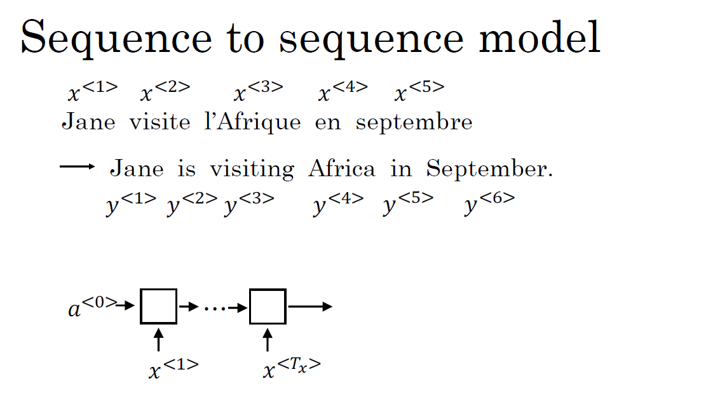
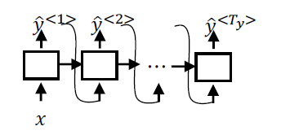

Slide 6
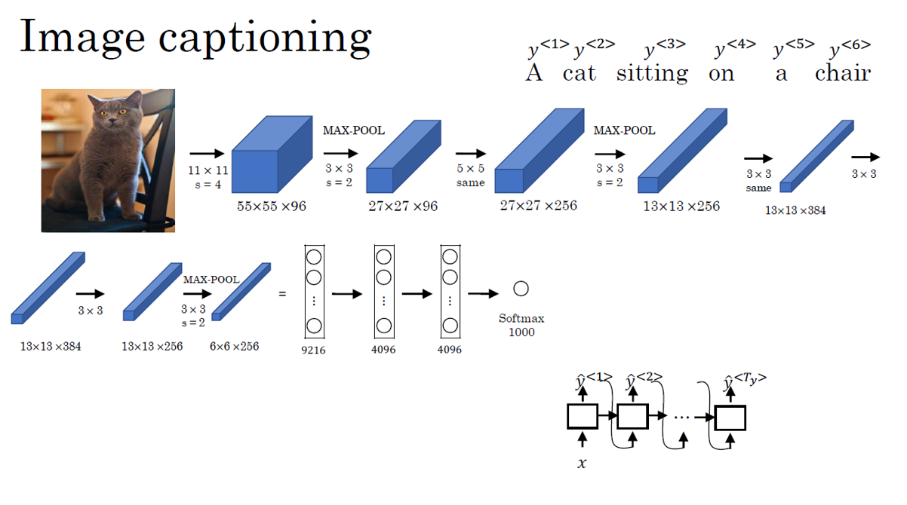


Slide 7
Sequence to sequence models
Picking the most likely sentence

Slide 8
Picking the most likely sentence
In summary, language modeling involves estimating the probability of a sentence and generating new sentences, while seq2seq modeling involves estimating the probability of an output sentence given an input sentence, which is a conditional language model.
Seq2seq models consist of an encoder network that learns the representation of the input and a decoder network that generates the output sentence conditioned on the input representation, while language models do not require an explicit encoder-decoder structure.
Notes:
The similarities and differences between sequence-to-sequence (seq2seq) models for machine translation and language models:
- In language modeling, the goal is to estimate the probability of a sentence and generate novel sentences.
- In seq2seq modeling, the goal is to estimate the probability of an output sentence (e.g., English translation) given an input sentence (e.g., French). This is known as a conditional language model. The model consists of an encoder network that learns a representation of the input sentence and a decoder network that generates the output sentence one word at a time, conditioned on the input sentence representation.

Slide 9
Picking the most likely sentence
To find the English sentence that maximizes the conditional probability given the input French sentence in machine translation, approximate search algorithms like beam search are used instead of exhaustive enumeration due to the exponentially large space of all possible sentences in a language. Greedy search picks the most likely word at each step, but it results in suboptimal translations. Beam search, on the other hand, is an approximate search algorithm that tries to find the sentence that maximizes the conditional probability and usually does a good enough job.
Notes:
When using this model for machine translation, we don't want to sample outputs at random. Instead, we want to find the English sentence that maximizes the conditional probability given the input French sentence.
Greedy search picks the most likely word at each step, resulting in suboptimal translations.
Beam search is an approximate search algorithm that tries to find the sentence that maximizes the conditional probability. While not guaranteed to find the optimal sentence, beam search usually does a good enough job.
The space of all possible sentences in a language is exponentially large, making it impossible to exhaustively enumerate all possible translations. Therefore, approximate search algorithms like beam search are necessary to find the most likely translation.

Slide 10
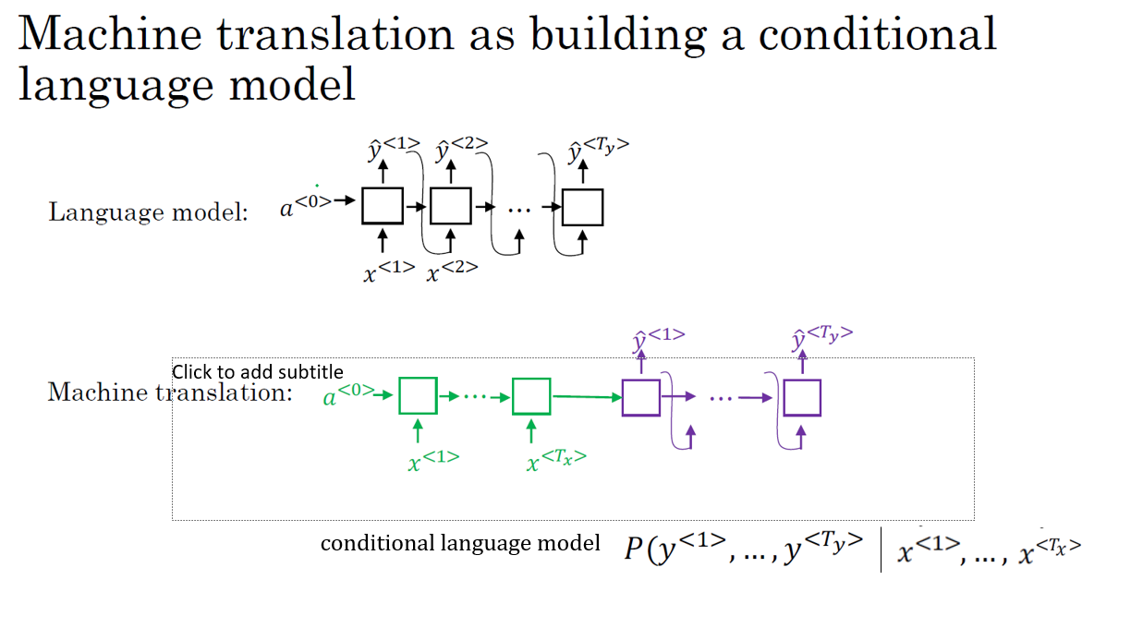
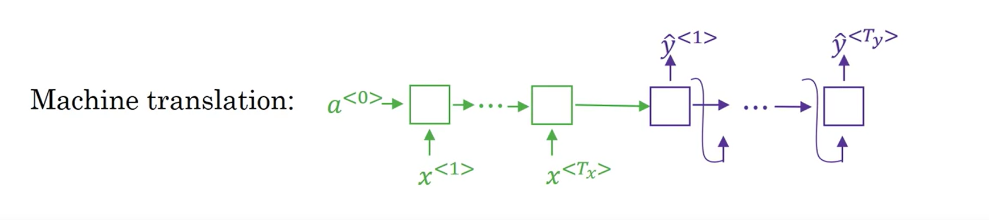

Slide 11
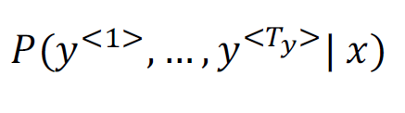
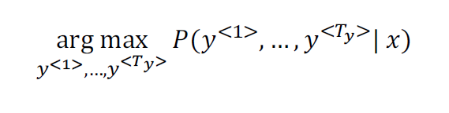
Finding the most likely translation
Jane visite l’Afrique en septembre.
Jane is visiting Africa in September.
Jane is going to be visiting Africa in September. In September, Jane will visit Africa.
Her African friend welcomed Jane in September.

Slide 12
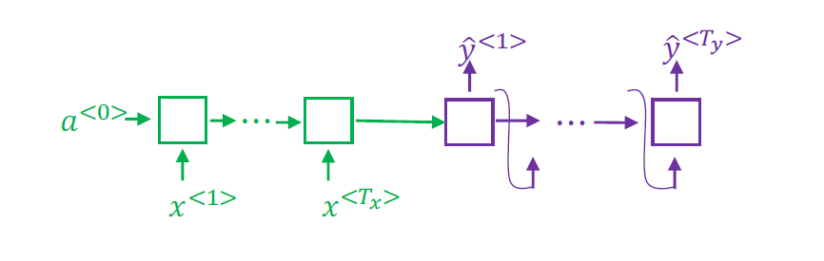
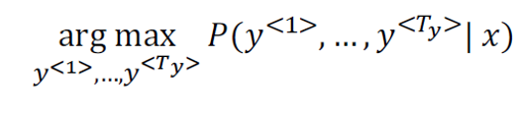
Why not a greedy search?
ŷ
ŷ
Jane is visiting Africa in September.
Jane is going to be visiting Africa in September.
P( Jane is going | x > Jane is visiting | x )

Slide 13
Sequence to sequence models
Beam search

Slide 14
Beam search
Beam search is a widely used search algorithm that is often used in natural language processing tasks such as machine translation, speech recognition, and text generation.
It considers multiple alternatives at each step of the sequence generation process, rather than just the most likely one, which is what greedy search does. The algorithm has a parameter called B, which is the beam width, and it determines the number of candidates to consider at each step. The outcome of this process is the most likely output sequence, given a set of input sequences and a pre-trained language model.
Notes:
Beam search is a widely used algorithm that considers multiple alternatives rather than just the most likely word, which is what greedy search does. The beam search algorithm has a parameter called B, which is called the beam width. For example, if the beam width is set to 3, beam search will consider three possibilities at a time.
Consider the running example of the French sentence "Jane, visite l'Afrique en Septembre" and how beam search works step by step. The first step of beam search is to pick the first words of the English translation. 10,000 words into vocabulary and uses a network fragment with the encoder in green and decoder in purple to evaluate the probability of the first output y, given the input sentence x, which is the French input. How to use network fragments to evaluate the probability of the second word, given the input French sentence and the first words of the translation?

Slide 15
Beam search
The process of beam search for the example French sentence "Jane, visite l'Afrique en Septembre" is summarized as follows:
Step 1: Pick the first word of the English translation and use a network fragment with an encoder in green and a decoder in purple to evaluate the probability of the first output word given the French input sentence.
Step 2: Consider the second word after the first and evaluate the possible choices using network fragments with hardwired first and second words. The most likely pair of the first and second words is selected by multiplying their probabilities.
Step 3: Pick the top three possibilities for the third word. The most likely output English sentence is the outcome of this process. If the beam width was set to 1, beam search becomes greedy search, which considers only one possibility at a time.
There are additional tips and tricks that can help make beam search work even better. The next section will discuss these tips and tricks.

Slide 16
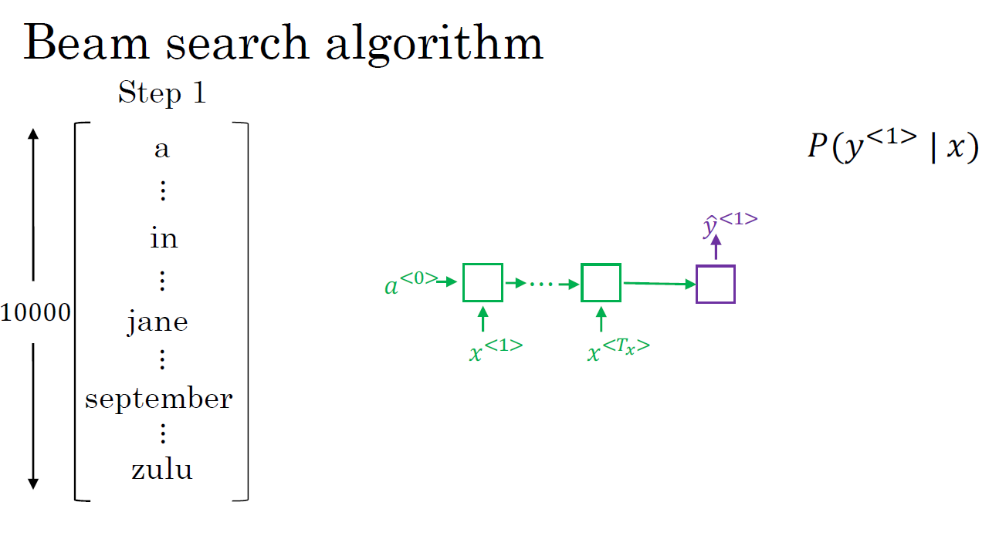

Slide 17
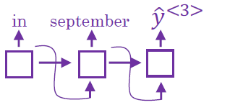
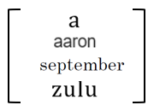
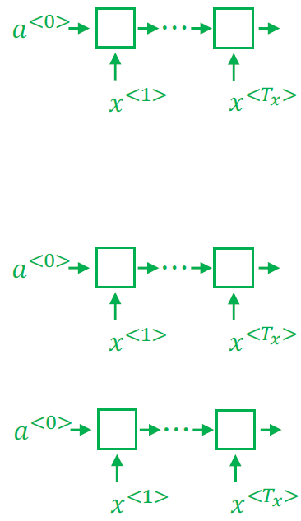
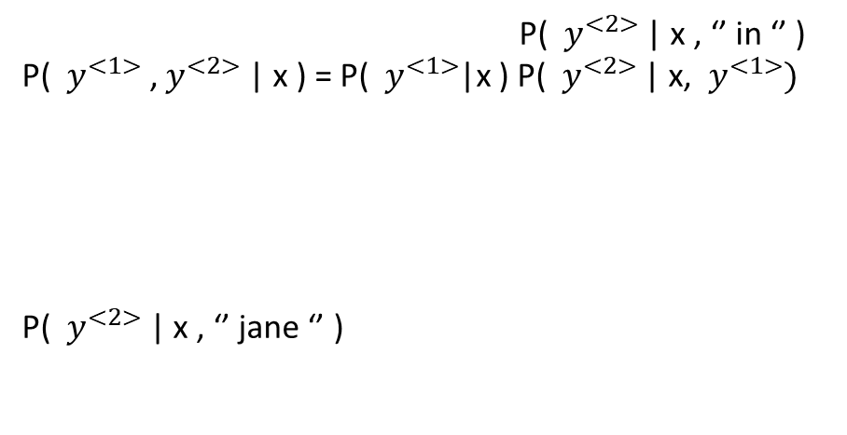
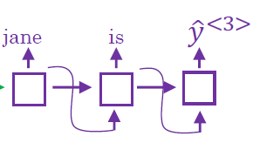
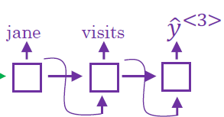
Beam search algorithm
Step 1 a
⋮
in
⋮
jane
⋮
september
⋮
zulu
Step 2
10000

Slide 18

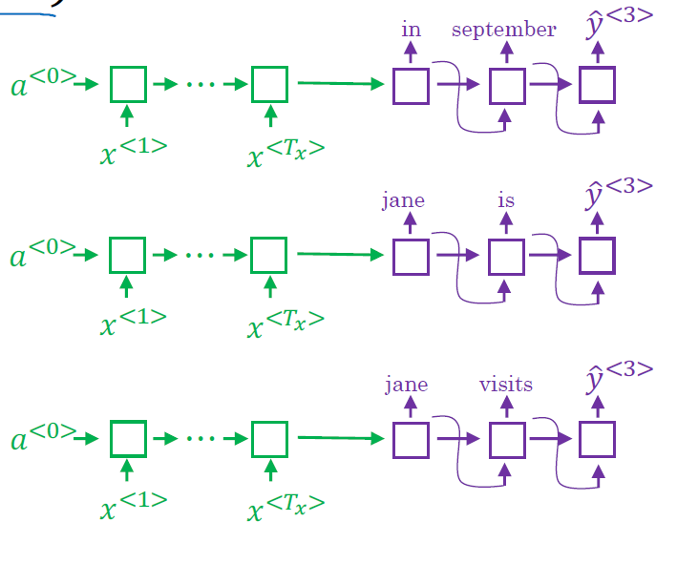
Beam search (B = 3)
in september
jane is
jane visits

Slide 19
Sequence to sequence models
Refinements to beam search

Slide 20
Refinements to beam search
Two modifications to the beam search algorithm used for machine translation: length normalization and normalizing the objective by the number of words in the translation.
Length normalization involves maximizing the sum of logarithms of probabilities instead of maximizing the product of probabilities.
The second modification uses a heuristic formula that reduces the penalty for longer translations while still providing some normalization. The algorithm keeps track of the top three possibilities for each possible sentence length up to the maximum length considered, and the translation with the highest value on the normalized log-likelihood objective is selected.
Trying different beam widths can help find the best value for a given task.
While beam search is faster, it is not guaranteed to find the exact maximum compared to exact search algorithms like PAFs Breakfast or DFS DEFA search, and the next section will cover error analysis on beam search.
Notes:
In the previous section, the basic search algorithm, beam search, was introduced as a way to select the most likely translation of a sentence given a source sentence in machine translation. In this section, the instructor introduces two small changes to the algorithm that can lead to better results.
The first change is called length normalization. When implementing beam search, the product of probabilities of all words in the translation is often used as the objective to be maximized. However, because probabilities are usually numbers less than one, multiplying them can lead to a tiny number that is too small for the computer's floating point representation to store accurately. To solve this problem, instead of maximizing the product of probabilities, the sum of logarithms of probabilities can be maximized, which is a more numerically stable algorithm. Moreover, this change can reduce the penalty for longer translations, which are often unfairly penalized because they involve multiplying more probabilities together.
The second change is to normalize the objective by the number of words in the translation. Instead of dividing by the number of words, a heuristic formula can be used that reduces the penalty for longer translations while still providing some normalization. This parameter, called Alpha, can be tuned to find the best value for the given task.
How to implement beam search by keeping track of the top three possibilities for each possible sentence length up to the maximum length considered? The algorithm then selects the translation with the highest value on the normalized log-likelihood objective.
A larger beam width results in better results but requires more memory and is slower, while a smaller beam width results in worse results but is faster and requires less memory. Trying a variety of beam widths to find the best value for the given task.
Beam search is a faster but not guaranteed to find the exact maximum for the objective compared to exact search algorithms such as PAFs Breakfast or DFS DEFA search.
The next section will discuss error analysis on beam search and how it can help improve the search algorithm.

Slide 21
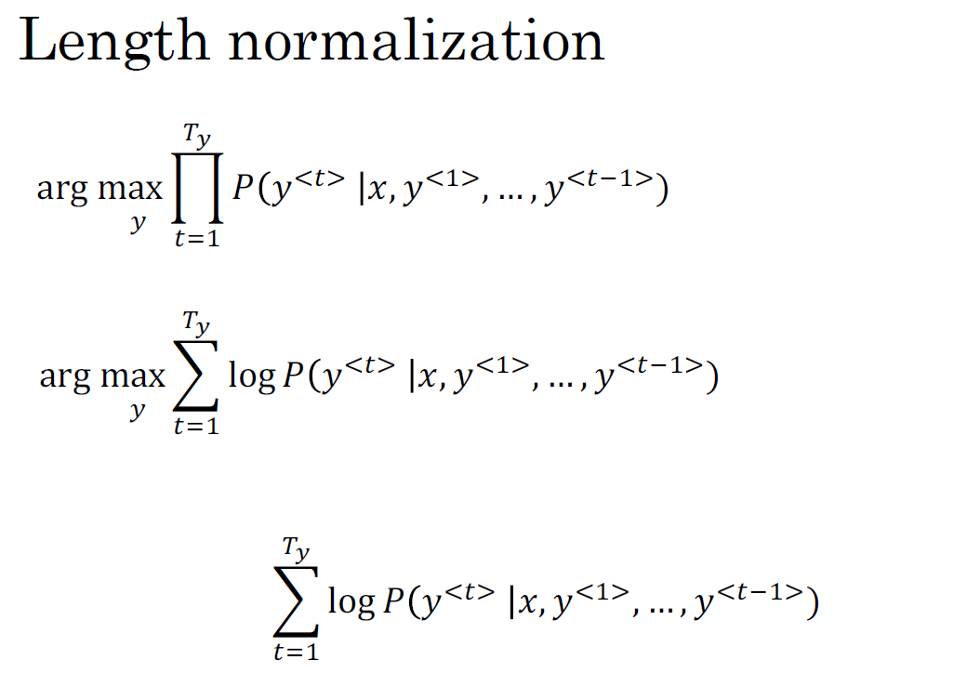
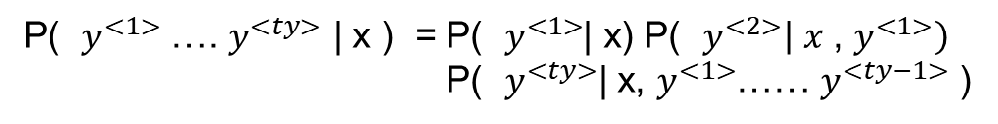

Slide 22
Beam search discussion
Beam width B?
1 > 3 > 10 , 100 , 1000 , > 3000
Large B : better result , slower
Small B : worse result , faster
Unlike exact search algorithms like BFS (Breadth First Search) or DFS (Depth First Search), Beam Search runs faster but is not guaranteed to find exact maximum for arg max )P(y|x).
'

Slide 23
Sequence to sequence models
Error analysis on beam search

Slide 24
Error analysis on beam search
How can error analysis be used with beam search to identify whether errors in machine translation arise from the beam search algorithm or the RNN model that generates the translation?
Beam search keeps track of the top B possibilities but is an approximate search algorithm that may not always output the most likely sentence. To determine if errors are due to beam search or the RNN model, the probabilities P(y<*> |x) and P(ŷ | x) are computed using the RNN model to see which is greater.
If P(y<*> |x) ≤ P(ŷ | x), the RNN model is at fault
if P(y<*> |x) > P(ŷ | x), the fault lies with beam search.
Through error analysis, the responsible component can be identified and improved upon, be it the beam width or the RNN model.
Notes:
The section discusses how to use error analysis with beam search to determine whether errors in machine translation are due to the beam search algorithm or the RNN model that generates the translation.
Beam search is an approximate search algorithm that does not always output the most likely sentence, but instead keeps track of the top B possibilities. If beam search makes a mistake, it is important to figure out whether it is the algorithm or the model that is causing problems.
To do error analysis with beam search, you need to compute P(y* given x) and P(y-hat given x) using your RNN model and see which of the two is bigger. There are two cases: case 1 is when P(y* given x) is greater than P(y-hat given x), indicating that beam search is failing to give the value of y that maximizes P(y given x) and is therefore at fault. Case 2 is when P(y* given x) is less than or equal to P(y-hat given x), indicating that the RNN model is at fault.
To carry out error analysis, you go through the development set and find the mistakes made by the algorithm, looking at the probabilities for each. For each example where the algorithm gives a much worse output than the human translation, you try to ascribe the error to either the search algorithm or the RNN model that generates the objective function that beam search is supposed to be maximizing. Through this process, you can figure out which component is responsible for more errors and decide whether to increase the beam width or work on the RNN model.
Overall, error analysis using beam search is a useful process when working with approximate optimization algorithms such as beam search that are optimizing some sort of objective function output by a learning algorithm such as a sequence-to-sequence model or sequence-to-sequence RNN.

Slide 25


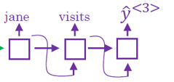
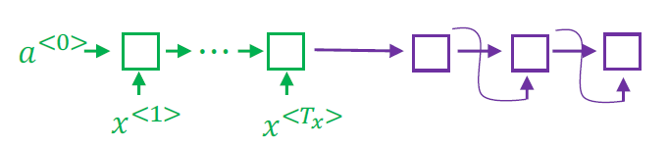
Example
Jane visite l’Afrique en septembre.
Human: Jane visits Africa in September. Algorithm: Jane visited Africa last September.

Slide 26
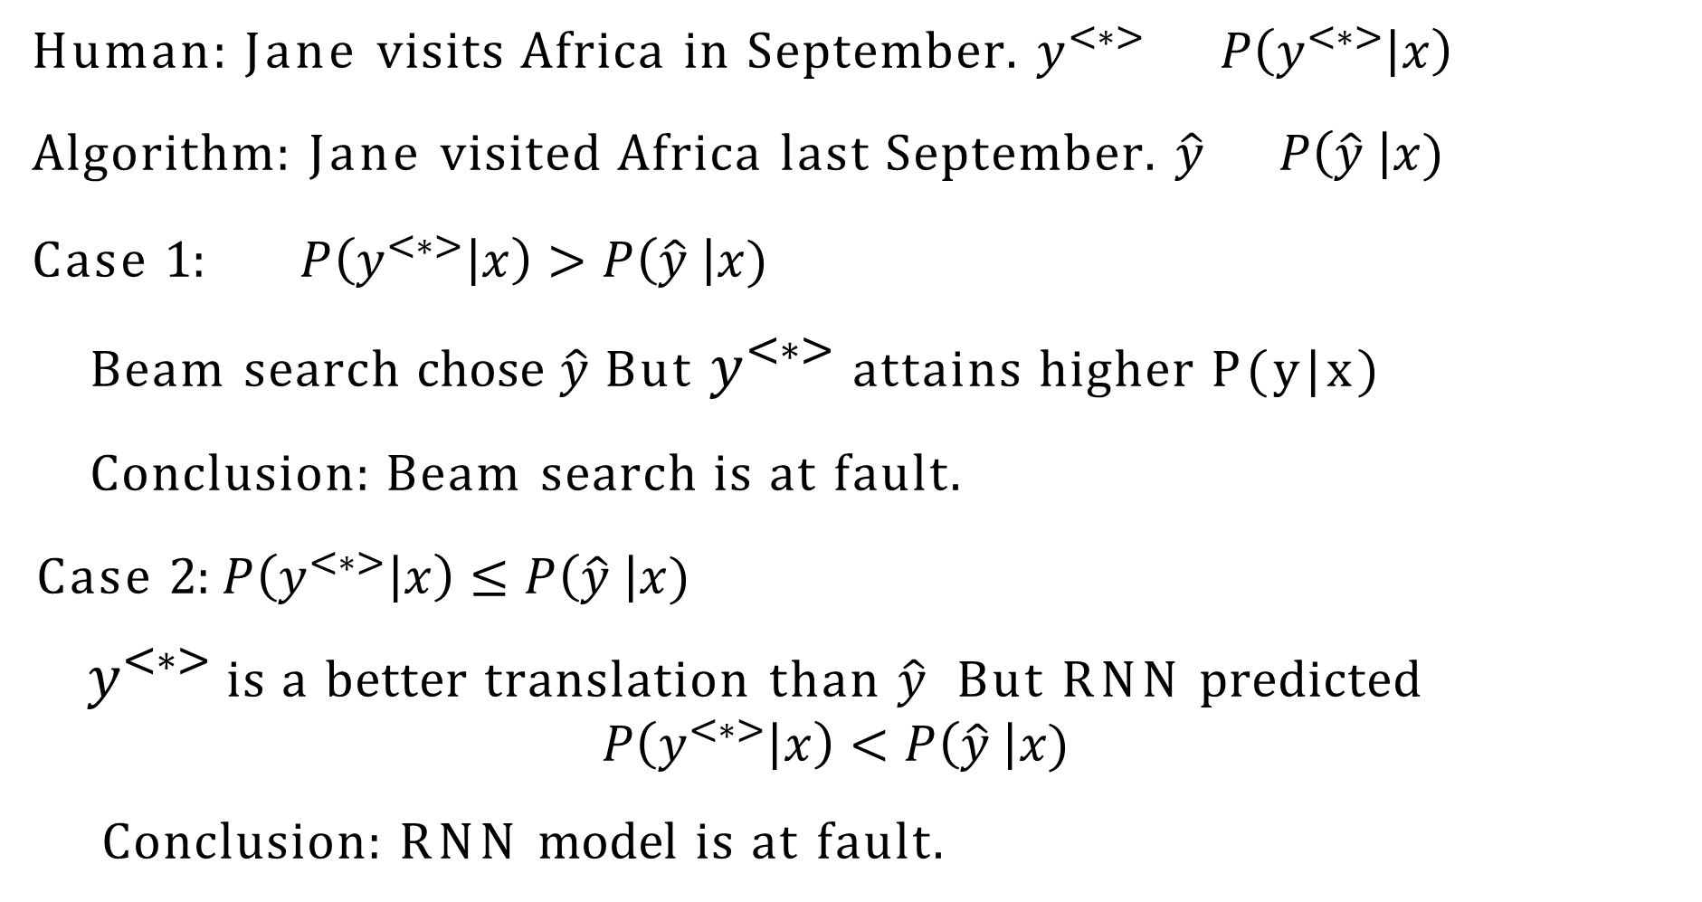
Error analysis on beam search

Slide 27
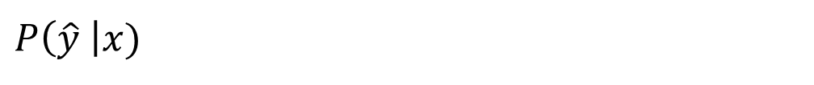
Error analysis process
Human
Algorithm
At fault?
Jane visits Africa in September.
Jane visited Africa last September.
B
R
B
R
R
.
.
.
Figures out what faction of errors are “due to” beam search vs. RNN model

Slide 28
Sequence to sequence models
Bleu score (optional)

Slide 29
Bleu score (optional)
The BLEU score evaluates machine-generated translations' quality by measuring similarity to human-generated translations.
It's based on precision, counting words in the machine output that appear in human references. To avoid favoring poor translations with the same words, a modified precision measure is used, limiting word counts to their maximum in the reference sentences.
Notes:
The BLEU score is a metric used to evaluate the quality of machine-generated translations. One of the challenges in evaluating machine translation systems is that there could be multiple equally good translations for a single sentence. The BLEU score measures how similar the machine-generated translation is to human-generated translations.
The BLEU score is based on precision, which measures the number of words in the machine-generated output that appear in the human-generated references. However, a simple precision measure is not enough because it can give a high score to poor translations that happen to contain the same words as the reference. Therefore, a modified precision measure is used, which clips the count of each word to the maximum number of times it appears in the reference sentences.

Slide 30
Bleu score (optional)
BLEU Score Components:
Involves unigrams, bigrams, trigrams, and higher-order n-grams.
Computes modified precision for each, considering occurrences in both machine-generated and reference texts.
Calculation Method:
Modified precision for bigrams is calculated similarly to unigrams.
Counts are based on the frequency of each bigram in machine-generated output and references.
Final BLEU Score:
Computed by averaging modified precision scores for all n-grams.
Includes brevity penalty adjustment for ...

Slide 31
Evaluating machine translation
French: Le chat est sur le tapis.
Reference 1: The cat is on the mat. Reference 2: There is a cat on the mat. MT output: the the the the the the the.
Precision: Modified precision:

Slide 32

Bleu score on bigrams
Reference 1: The cat is on the mat. Reference 2: There is a cat on the mat. MT output: The cat the cat on the mat.
Example:
Count countclip
the cat cat the cat on on the the mat
1
0
1
1
1
2
1
1
1
1

Slide 33
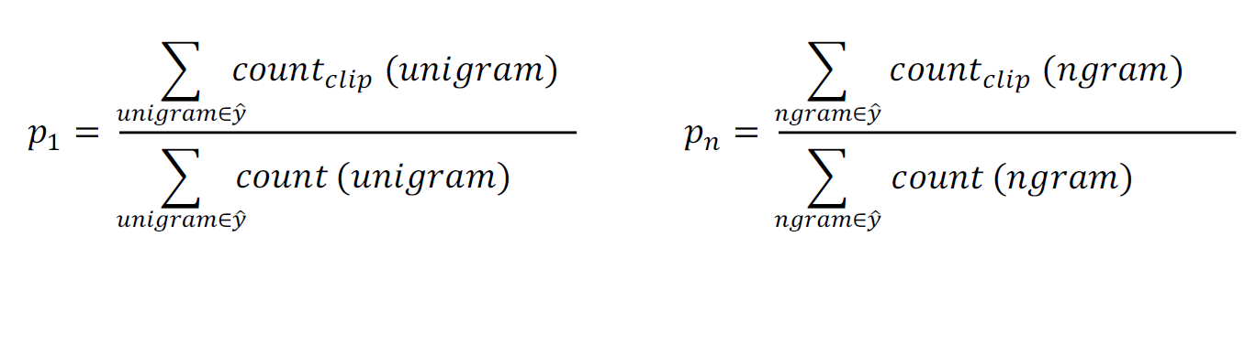
Bleu score on unigrams
Reference 1: The cat is on the mat. Reference 2: There is a cat on the mat. MT output: The cat the cat on the mat.
Example:

Slide 34
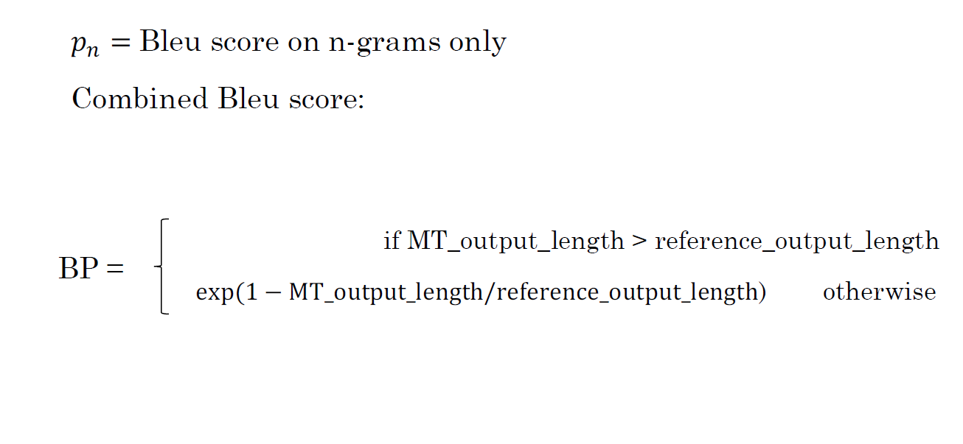
Bleu details
1

Slide 35
Sequence to sequence models
Attention model intuition

Slide 36
Attention model intuition
The Encoder-Decoder architecture is a commonly used model for machine translation, but struggles to effectively translate long sentences as it tries to memorize the whole sentence before generating the translation.
The Attention Model addresses this issue by allowing the model to focus on different parts of the input sentence at different times while generating the translation. This is achieved through attention weights that determine how much attention the model should pay to each part of the input sentence when generating each word in the output sentence.
Notes:
In machine translation, the Encoder-Decoder architecture is a commonly used model where one RNN reads in a sentence in one language (the source language), and another RNN outputs a sentence in another language (the target language). However, for long sentences, the Encoder-Decoder architecture struggles to translate effectively. This is because it tries to memorize the whole sentence before generating the translation, which is not how humans translate.
The Attention Model was developed as a modification to the Encoder-Decoder architecture to address this issue. The basic idea of the Attention Model is to allow the model to focus on different parts of the input sentence at different times while generating the translation. This is done by introducing attention weights, which determine how much attention the model should pay to each part of the input sentence when generating each word in the output sentence.
The attention weights are computed based on the hidden states of the bidirectional RNN that reads in the input sentence and the hidden state of the RNN that generates the output sentence. The bidirectional RNN computes a rich set of features for each word in the input sentence, and the attention weights tell the model how much weight to assign to each of these features when generating each word in the output sentence.
By using attention, the model can effectively translate long sentences by focusing on only the relevant parts of the input sentence at each step. This leads to a more accurate translation and higher BLEU scores.
The Attention Model was first introduced in a seminal paper by Bahdanau et al. and has since become one of the most influential ideas in deep learning, not just in machine translation but also in other areas such as image captioning and speech recognition.

Slide 37
The problem of long sequences
Jane s'est rendue en Afrique en septembre dernier, a apprécié la culture et a rencontré beaucoup de gens merveilleux; elle est revenue en parlant comment son voyage était merveilleux, et elle me tente d'y aller aussi.
Jane went to Africa last September, and enjoyed the culture and met many wonderful people; she came back raving about how wonderful her trip was , and is tempting me to go too.
Bleu score
10
20
30
40
50
Sentence length

Slide 38
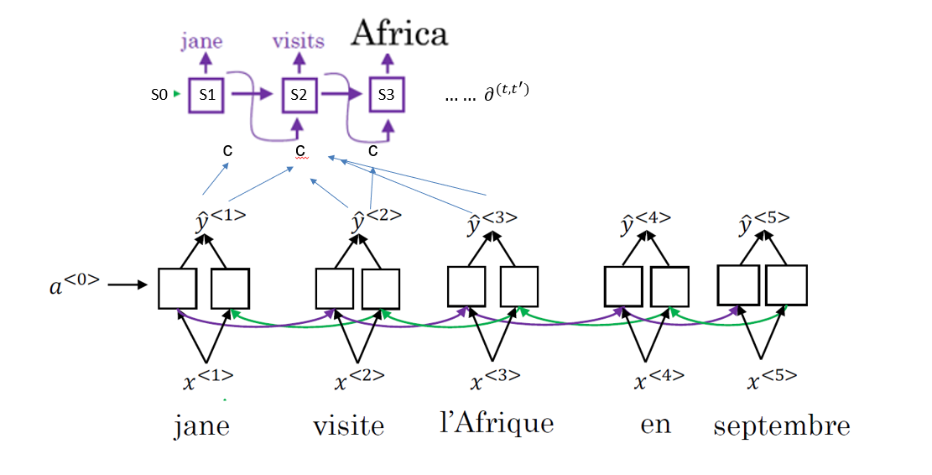
Attention model intuition

Slide 39
Sequence to sequence models
Attention model

Slide 40
Attention model
The Attention model, crucial in machine translation, enables a neural network to focus on specific input sequence parts while generating an output.
Implemented with bidirectional RNNs, GRUs, or LSTMs, it computes features for each input sentence word. A forward-only RNN generates the translation, utilizing a context vector for each time step. This vector sums features from different steps, weighted by attention weights computed through a small neural network.
The Attention model finds applications beyond translation, like image captioning, despite its quadratic time complexity, prompting ongoing research for cost reduction.
Notes:
The attention model is a technique in deep learning that allows a neural network to focus on certain parts of an input sequence while generating an output. In the context of machine translation, an attention model is used to generate a translation by paying attention to relevant parts of the input sentence. To implement an attention model, you start by using a bidirectional RNN, GRU, or LSTM to compute features on every word in the input sentence. The features computed from the forward occurrence and from the backward occurrence in the bidirectional RNN are concatenated together to form a feature vector for each time step. Then, a forward-only RNN is used to generate the translation, with a context vector as input for each time step. The context vector is defined as a sum of the features from the different time steps, weighted by attention weights that determine how much attention to pay to each feature. These attention weights are computed using a small neural network that takes as input the previous hidden state of the RNN generating the translation and the features of the input sentence. The neural network is trained with gradient descent to learn the appropriate attention weights for each time step.
While the attention model was originally developed for machine translation, it has also been applied to other problems, such as image captioning. In the programming exercise, you can implement and play with the attention model while solving the date normalization problem. The attention weights can also be visualized, showing which parts of the input sequence the model is paying attention to when generating each output word. The main downside of the attention model is its quadratic time complexity, but there are research efforts to reduce this cost.

Slide 41
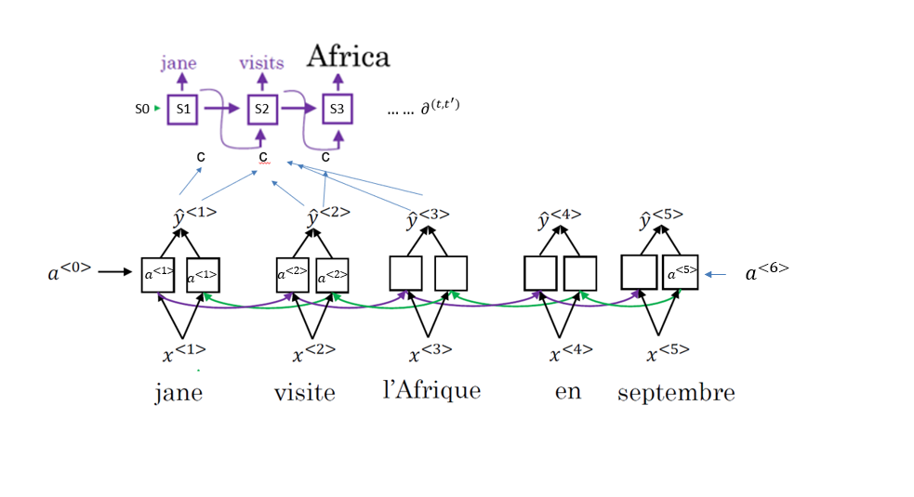
Attention model

Slide 42
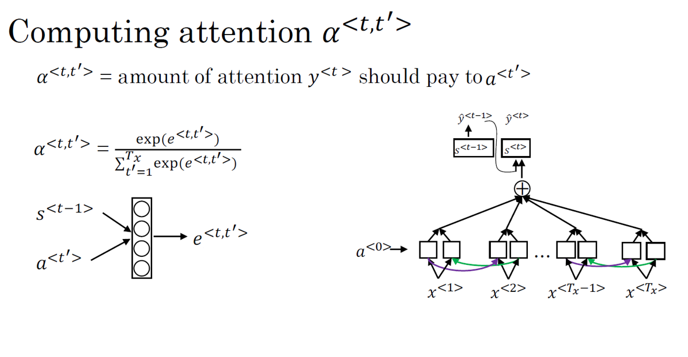

Slide 43
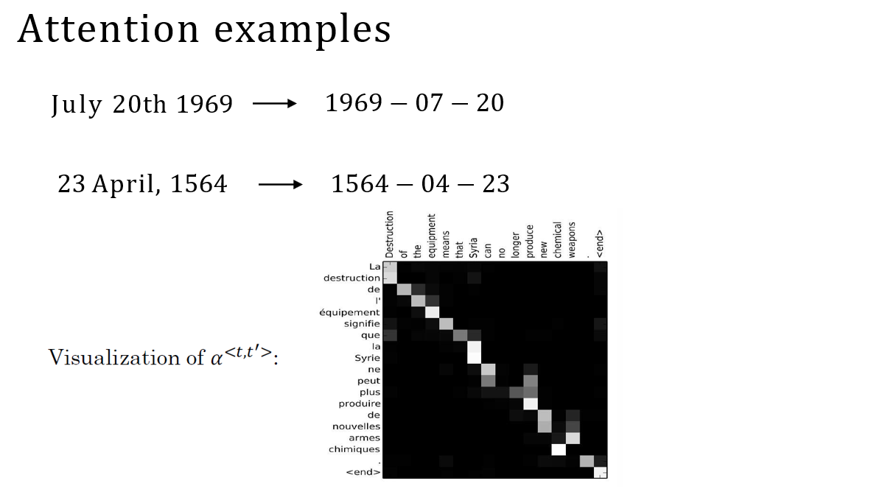

Slide 44
Audio data
Speech recognition

Slide 45
Speech recognition
Speech recognition involves converting an audio clip into a text transcript, typically using a spectrogram as input to a deep learning model.
End-to-end deep learning models can input raw audio and directly output the transcript.
One approach is to use an attention model, while another is to use the CTC cost for speech recognition.
A trigger word detection system can be built with a smaller dataset than is required for full speech recognition.
Notes:
Speech recognition is the task of converting an audio clip into a text transcript. This is typically done by processing the audio clip to create a spectrogram, which is a visual representation of the sound waves in the clip. The spectrogram shows the intensity of different frequencies at different points in time. Speech recognition models use this spectrogram as input to predict the corresponding text transcript.
In the past, speech recognition systems used to be built using phonemes, which are the basic units of sound in a language. These phonemes were hand-engineered and used to transcribe audio data. However, with end-to-end deep learning, phoneme representations are no longer necessary. Instead, deep learning models can input the raw audio clip and directly output the transcript without the need for hand-engineered representations.
One approach to building a speech recognition system is to use an attention model. This model takes in different time frames of the audio input and uses an attention mechanism to output the corresponding transcript.
Another approach is to use the CTC (Connectionist Temporal Classification) cost for speech recognition. This approach involves using a neural network with an equal number of input and output units. The network generates an output sequence that includes a special "blank" character, which allows the network to repeat characters and insert blanks to represent a longer output sequence. The CTC cost function collapses repeated characters not separated by the "blank" character to create the final output sequence.
Building effective speech recognition systems requires a large dataset of transcribed audio. However, a simpler task, such as building a trigger word detection system, can be done with a smaller dataset. In the next video, the speaker will discuss how to build a trigger word detection system.

Slide 46
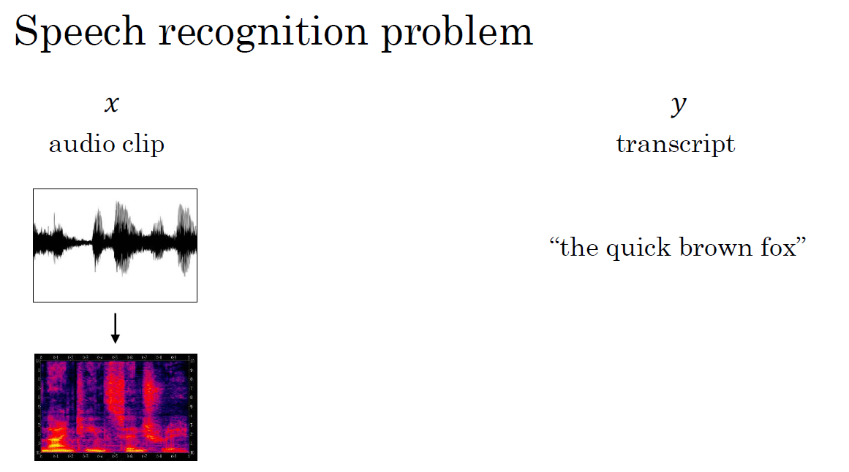

Slide 47
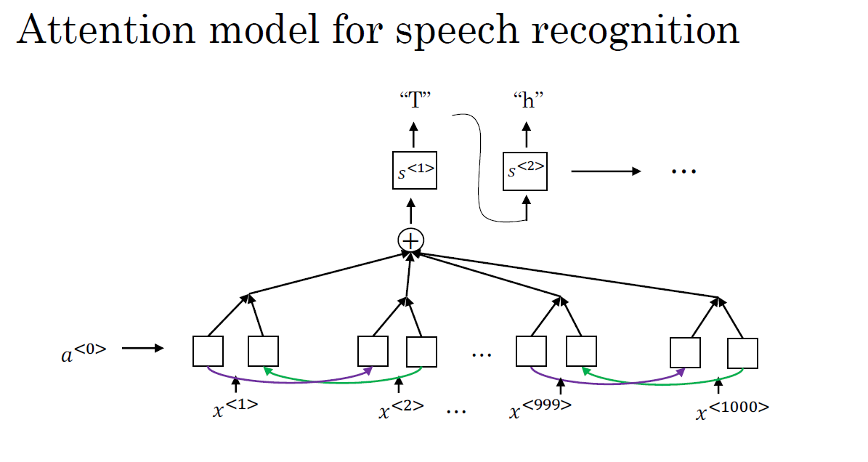

Slide 48
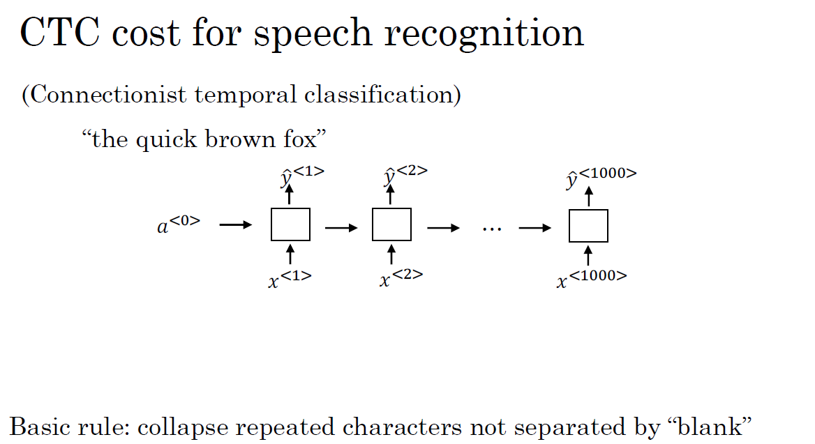

Slide 49
Audio data
Trigger word detection

Slide 50
Trigger word detection
To build a trigger word detection system, an RNN model is trained using spectrogram features of audio clips and target labels indicating the presence or absence of the trigger word. The target label is set to 1 right after the trigger word is spoken, and possibly multiple 1s are outputted for a fixed period of time to balance the ratio of 1s to 0s in the training set.
There is no consensus on the best algorithm for trigger word detection, but an RNN is one example presented in this module.
Notes:
This section explains how to build a trigger word detection system using deep learning and sequence models. Trigger word systems are devices that can be woken up with a specific word or phrase, such as "Alexa" for the Amazon Echo or "Hey Siri" for Apple's Siri. There is no consensus on the best algorithm for trigger word detection, but presents one example that involves using an RNN.
To train the RNN for trigger word detection, the audio clip is passed through the RNN after being processed into spectrogram features. Target labels are then defined to indicate when the trigger word is spoken in the audio clip. Setting the target label to 1 right after the trigger word is spoken, and possibly outputting multiple 1s for a fixed period of time to balance out the ratio of 1s to 0s in the training set.

Slide 51




What is trigger word detection?
Amazon Echo (Alexa)
Baidu DuerOS (xiaodunihao)
Apple Siri (Hey Siri)
Google Home (Okay Google)

Slide 52
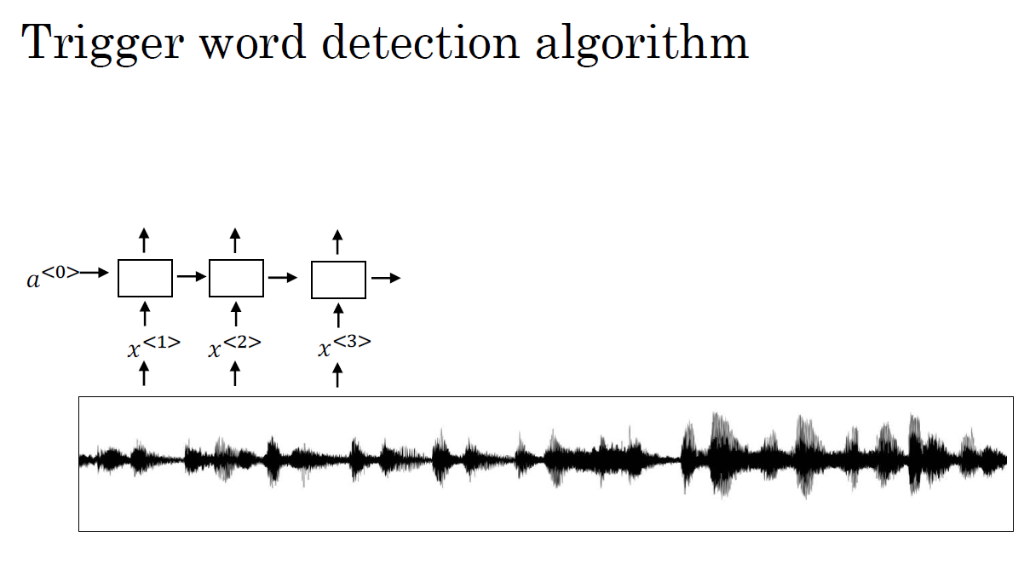
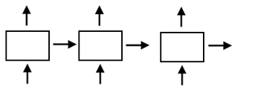
0 0 0 1 1 0

Slide 53
Summarization
Basic Models:
Introduction to basic models used in natural language processing and machine translation, often including encoder-decoder architectures.
Picking the Most Likely Sentence:
Discusses how to choose the most likely translation or sentence from a set of possible candidates generated by a machine translation system.
Beam Search:
Beam search is a decoding algorithm used in machine translation and other sequence generation tasks. It explores multiple possible sequences simultaneously, narrowing down the search space.
Refinements to Beam Search:
Describes improvements and refinements to the basic beam search algorithm, such as length normalization and diverse beam search.
Error Analysis on Beam Search:
Examines common errors made by beam search and discusses strategies for addressing these errors to improve translation quality.

Slide 54
Summarization
Bleu Score evaluates machine translation quality by comparing n-grams.
Attention in neural networks focuses on input parts during output generation.
Attention models enhance sequence-to-sequence models, improving translation.
Speech recognition converts spoken language to text using RNNs and attention.
Trigger word detection identifies specific words in audio, e.g., for voice assistants.
Notes:
Bleu Score (Optional):
The Bleu score is a metric used to evaluate the quality of machine translations by comparing them to reference translations. It measures the similarity of n-grams between the candidate and reference translations.
Attention Model Intuition:
Introduces the concept of attention in neural networks, which allows models to focus on different parts of the input sequence when generating output.
Attention Model:
Explains the architecture of attention models, which enhance sequence-to-sequence models by attending to relevant parts of the input during decoding, improving translation quality.
Speech Recognition:
Speech recognition is the task of converting spoken language into text. It involves models like recurrent neural networks (RNNs) and attention-based models.
Trigger Word Detection:
Trigger word detection involves identifying specific words or phrases in audio data, often used in applications like voice assistants to activate them.

